Slide 1


What is WordPress?
WordPress is a popular and powerful content management system (CMS) that powers millions of websites and blogs worldwide. It is an open-source platform that allows users to easily create, manage, and customize their online presence without extensive coding knowledge.
by Mohammad Javad Sharifi

Slide 2
WordPress Features
Intuitive Interface
Customizable Themes
Extensive Plugins
WordPress offers an easy-to-use dashboard that makes website management and content creation a breeze, even for non-technical users.
WordPress has a vast library of free and premium themes, allowing users to choose a design that perfectly fits their brand and website needs.
WordPress users can extend the platform's functionality by installing a wide range of plugins, from e-commerce to SEO, security, and more.

Slide 3
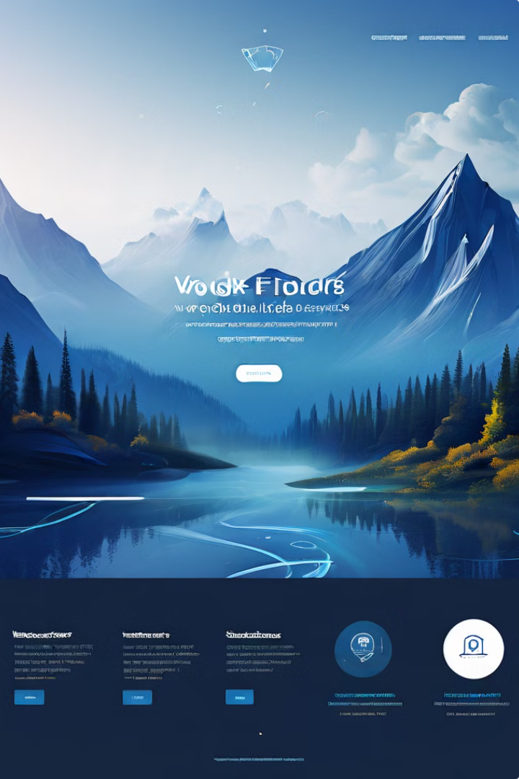
WordPress Themes
1
Responsive Design
WordPress themes are designed to be mobile-friendly, ensuring a seamless experience across devices.
2
Diverse Options
WordPress offers thousands of free and premium themes, catering to a wide range of industries and personal preferences.
3
Customization
Many WordPress themes are highly customizable, allowing users to tailor the design to their specific needs.
4
Regular Updates
WordPress theme developers regularly update their products to ensure compatibility and security.

Slide 4

WordPress Plugins
Boost Functionality
WordPress plugins can add a wide range of features and capabilities to a website, from e-commerce to SEO and social media integration.
Streamline Workflows
Plugins can automate repetitive tasks, saving users time and effort in managing their WordPress websites.
Enhance User Experience
Plugins can improve the overall user experience of a WordPress site, making it more engaging and interactive for visitors.
Maintain Security
WordPress plugins can also play a crucial role in safeguarding a website by providing security features and updates.

Slide 5
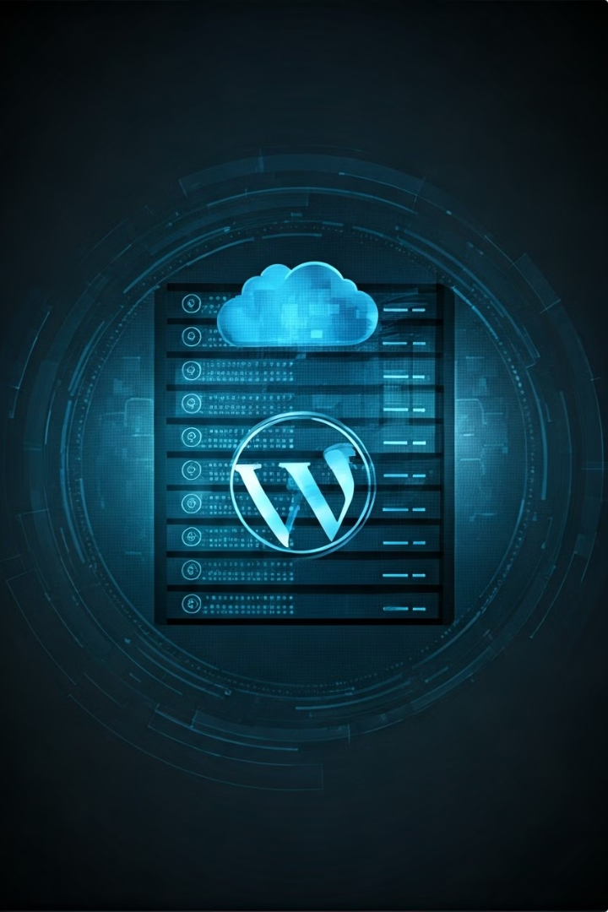
WordPress Hosting
1
Reliable Servers
WordPress hosting providers offer high-performance servers to ensure fast and reliable website performance.
2
Automatic Updates
Managed WordPress hosting plans often include automatic updates for the core WordPress software, themes, and plugins.
3
Enhanced Security
WordPress hosting providers implement robust security measures to protect websites from cyber threats and vulnerabilities.

Slide 6





WordPress Security
Access Control
Firewall Protection
Regular Updates
Data Backups
Secure user authentication and access management to prevent unauthorized access to the WordPress site.
Robust firewall solutions to safeguard the WordPress site from malware, hacking attempts, and other cyber threats.
Timely updates for the WordPress core, themes, and plugins to address security vulnerabilities and maintain optimal performance.
Regularly scheduled backups to ensure data recovery in the event of a security breach or system failure.

Slide 7





WordPress SEO
Keyword Research
Identifying the right keywords and phrases to target for improved search engine visibility.
Optimized Content
Creating high-quality, SEO-friendly content that resonates with both users and search engines.
Meta Tags and Titles
Crafting compelling meta titles and descriptions to enhance click-through rates from search results.
Plugin Integration
Leveraging WordPress SEO plugins to streamline optimization and track performance metrics.

Slide 8

WordPress Ecommerce
Product Management
Easily add, edit, and organize products and inventory within the WordPress dashboard.
Secure Checkout
Integrated payment gateways and SSL encryption to provide a safe and seamless checkout experience.
Customizable Designs
WordPress ecommerce plugins allow for creating a unique and visually appealing online store.
Reporting and Analytics
Track sales, revenue, and customer behavior to make informed business decisions.

Slide 9
WordPress Blogging
Intuitive Publishing
Media Integration
Audience Engagement
WordPress offers a user-friendly content management system that simplifies the blog writing and publishing process.
Easily incorporate images, videos, and other multimedia elements to create visually engaging blog posts.
WordPress enables features like comments, social sharing, and subscriber management to foster audience interaction and community building.

Slide 10

WordPress Support and Resources
Extensive Documentation
The WordPress.org website provides comprehensive documentation, tutorials, and guides to help users learn and troubleshoot the platform.
Active Community
A large and vibrant community of WordPress users and developers offer support, sharing knowledge, and collaborating on projects.
Professional Services
A wide range of WordPress experts, agencies, and developers offer professional services, such as custom theme and plugin development, website maintenance, and training.

